Slide 1

Smart Lock
Keep your mind at ease
Secure your most valuable assets without any hassle

Slide 2
Features of our Prototype
Portability, easily integrated into a variety of products (bicycles, motorbikes, handbags, luggage etc.).
Connectivity, long range and reliability with Wi-Fi 6.
Sound Alarm on movement detection.
Notification to user’s phone on the event that the device is moved when in locked state.
Secure, easy and contactless locking/unlocking by means of RFID cards and tags.

Slide 3
Ideal Product Features
Android app for device configuration (via Bluetooth).
Mobile Data (4G,5G) module for seamless internet connectivity.
110 dB buzzer for sound alarm.
Bluetooth keyless unlocking in addition to RFID unlocking.
GPS tracking
Very Low Idle Power Consumption

Slide 4

Use Cases

Slide 5

Smart Bicycle Lock
Prevention is better than cure.
Get notified instantly when your bike is tampered with.
The lock can be added to an existing bike or be integrated into new products, especially e-bikes of high value.
Can also be used for motorcycles

Slide 6

Luggage Protection
Sometimes our luggage can’t be with us.
Whether leaving your luggage at a hotel temporarily (before check-in), locking your luggage in luggage lockers or leaving it unattended at a hostel or Airbnb, it is always a good idea to lock it.
Your luggage is important.
Get notified if they are tampered with, instantly.

Slide 7
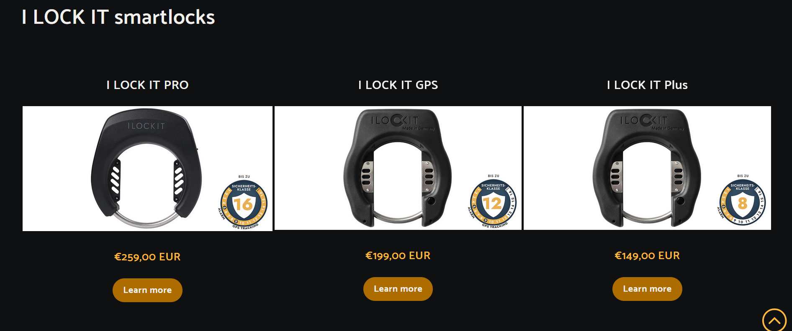
Market prices

Slide 8
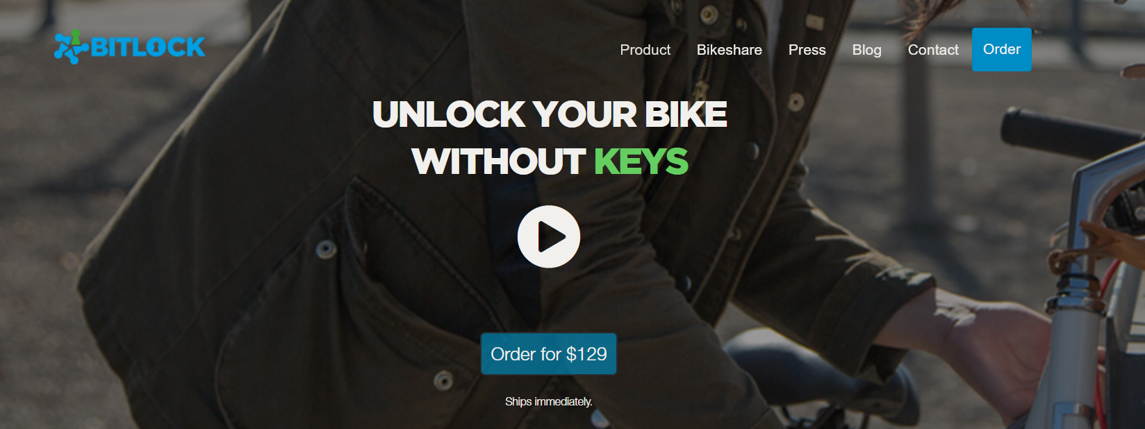

Slide 9
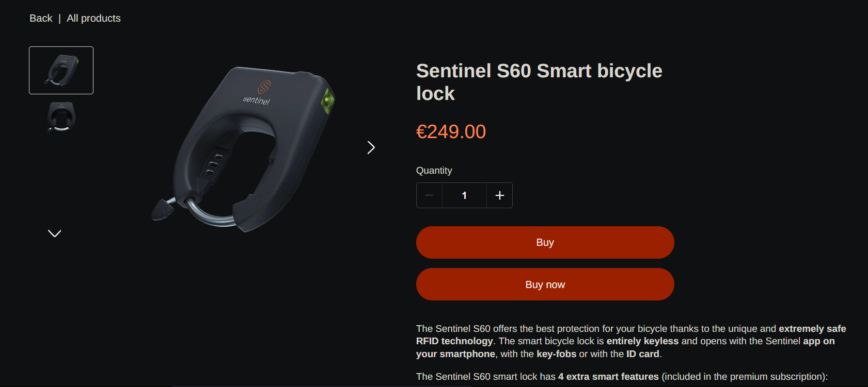

Slide 10
Components
ESP32 C6 SoC with WIFI 6 and Bluetooth LE capabilities (15€)
Triple Axis Gyroscope & Accelerometer IMU - MPU6050 (3.60€)
Mifare RC522 RFID Card Reader (4.80€)
Indicative LEDs (0.70€ each)
Buzzer (1.20€ euros)

Slide 11
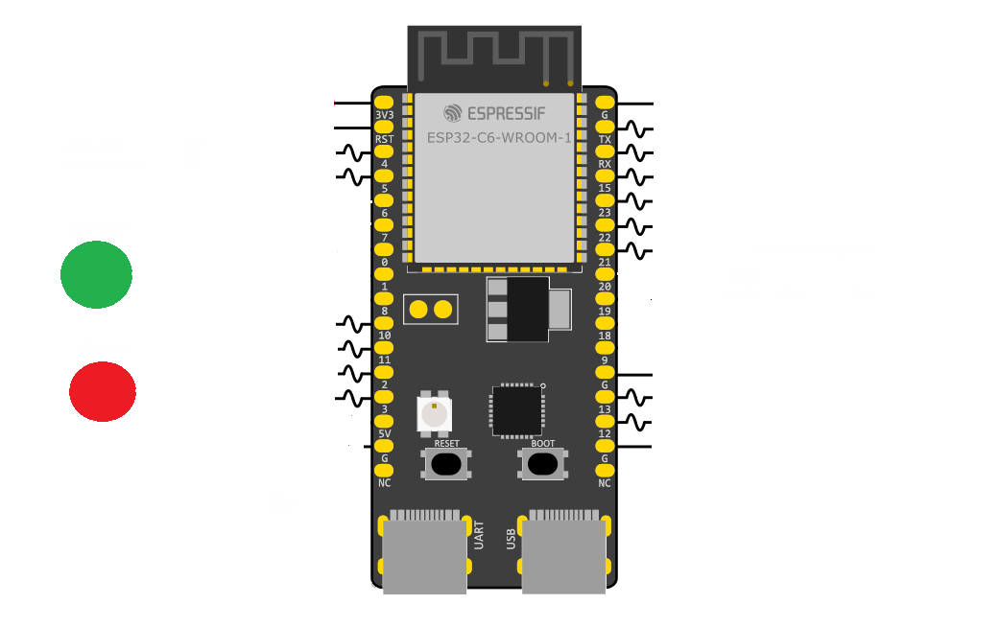
Schematic

Slide 12

Operation
User locks the device using the designated RFID card.
When movement is detected (in any direction) and exceeds the threshold set (hardcoded in prototype) then the sound alarm is activated.
A notification is sent to the user’s mobile phone alerting them of the thief.
The lock will remain locked until a valid RFID card is presented to the reader again.

Slide 13

Demonstration Time

